Slide 1
6
TECHNIQUES OF INTEGRATION

Slide 2
6.2
Trigonometric Integrals and Substitutions

Slide 3
Trigonometric Integrals

Slide 4

Trigonometric Integrals
Here we use trigonometric identities to integrate certain combinations of trigonometric functions. We start with powers of sine and cosine.
In general, we try to write an integrand involving powers of sine and cosine in a form where we have only one sine factor (and the remainder of the expression in terms of cosine) or only one cosine factor (and the remainder of the expression in terms of sine).
The identity enables us to convert back and forth between even powers of sine and cosine.

Slide 5
Example 1
Evaluate
SOLUTION
Simply substituting u = cos x isn’t helpful, since then du = – sin x dx.
In order to integrate powers of cosine, we would need an extra sin x factor.
Similarly, a power of sine would require an extra cos x factor.

Slide 6
Example 1 – Solution
Thus, here we can separate one cosine factor and convert the remaining cos²x factor to an expression involving sine using the identity sin²x + cos²x = 1: cos³x = cos²x‧cosx = (1 – sin²x) cosx

Slide 7
Example 1 – Solution
We can then evaluate the integral by substituting u = sin x.
So, du = cos x dx and

Slide 8
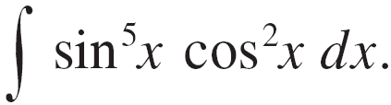



Example 2
Find
SOLUTION:
We could convert to but we would be left with an expression in terms of sin x with no extra cos x factor.
Instead, we separate a single sine factor and rewrite the remaining factor in terms of cos x:

Slide 9
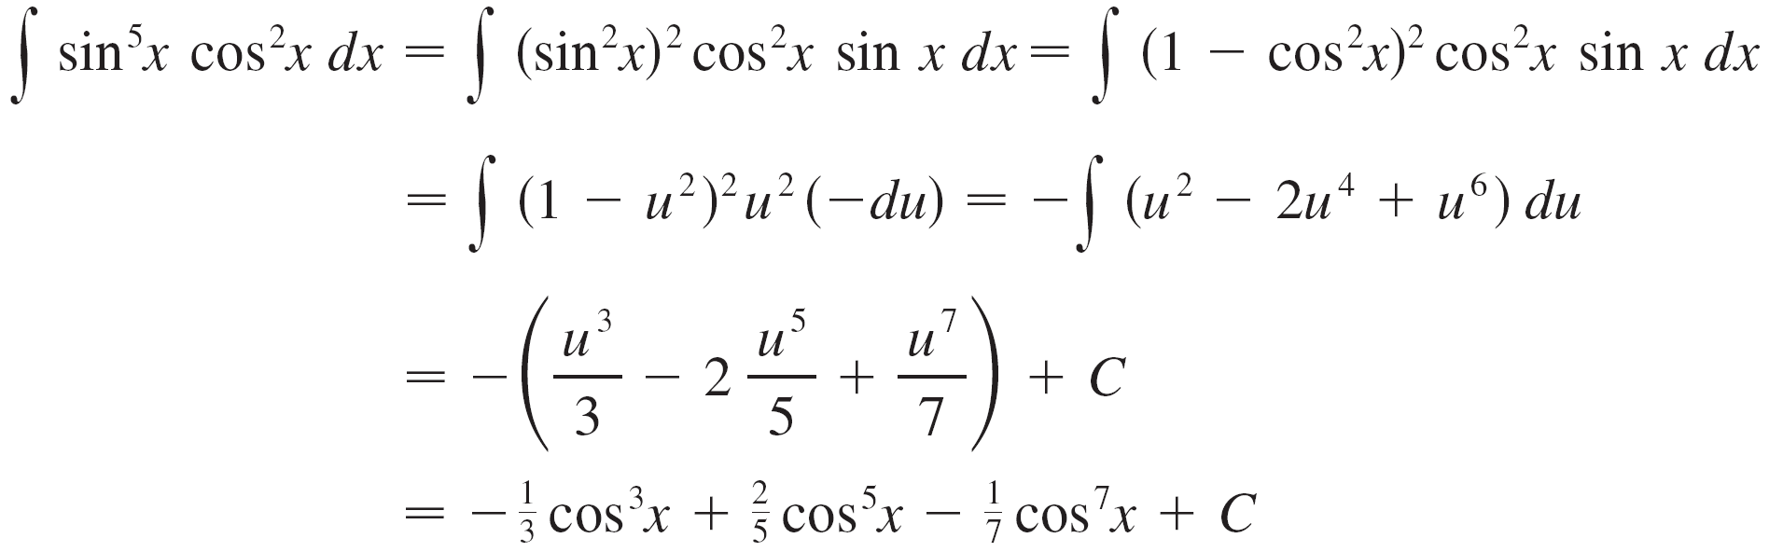
Example 2 – Solution
Substituting u = cos x, we have du = –sin x dx and so

Slide 10
Example 2 – Solution
cont’d

Slide 11
SINE & COSINE INTEGRALS
Figure 1 shows the graphs of the integrand sin⁵x cos²x in Example 2 and its indefinite integral (with C = 0).

Slide 12
SINE & COSINE INTEGRALS
In the preceding examples, an odd power of sine or cosine enabled us to separate a single factor and convert the remaining even power.
If the integrand contains even powers of both sine and cosine, this strategy fails.
In that case, we can take advantage of the following half-angle identities:

Slide 13
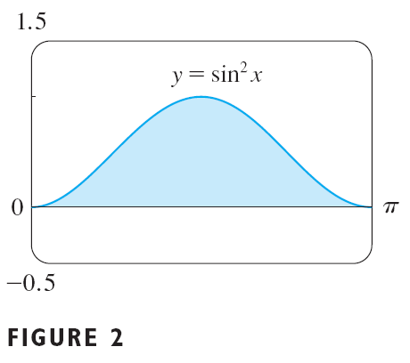
Example 3
Evaluate
SOLUTION
If we write sin²x = 1 – cos²x, the integral is no simpler to evaluate.

Slide 14
Example 3 – Solution
However, using the half-angle formula for sin²x, we have:
Notice that we mentally made the substitution u = 2x when integrating cos 2x.
Another method for evaluating this integral was given in Exercise 29 in Section 6.1.

Slide 15
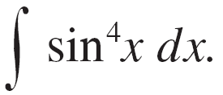


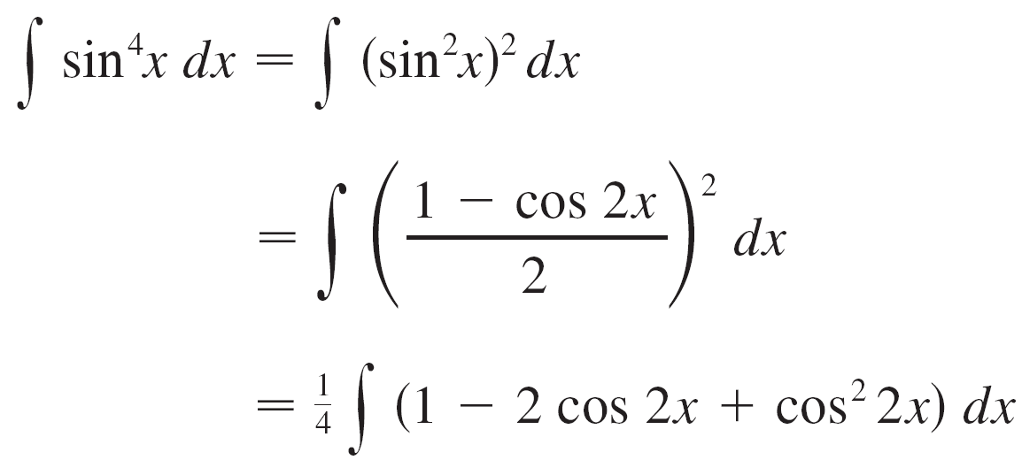
Example 4
Find
SOLUTION:
We evaluate this integral by writing and using the half-angle formula :

Slide 16

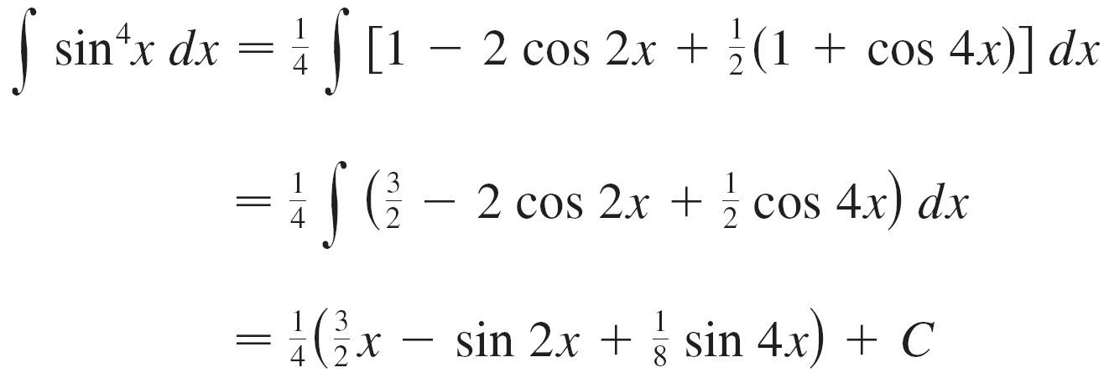
Example 4 – Solution
Since cos²2 x occurs, we must use another half-angle formula
This gives

Slide 17
Example 4 – Solution

Slide 18
SINE & COSINE INTEGRALS
To summarize, we list guidelines to follow when evaluating integrals of the form where m ≥ 0 and n ≥ 0 are integers.

Slide 19
How to Integrate Powers of sinx and cosx STRATEGY (i)
If the power of cosine is odd (n = 2k + 1), save one cosine factor.
Use cos²x = 1 – sin²x to express the remaining factors in terms of sine:
Then, substitute u = sin x.

Slide 20
STRATEGY (ii)
If the power of sine is odd (m = 2k + 1), save one sine factor.
Use sin²x = 1 – cos²x to express the remaining factors in terms of cosine:
Then, substitute u = cos x.
Note that, if the powers of both sine and cosine are odd, either (i) or (ii) can be used.

Slide 21
STRATEGY (iii)
If the powers of both sine and cosine are even, use the half-angle identities
Sometimes, it is helpful to use the identity

Slide 22



Trigonometric Integrals
We can use a similar strategy to evaluate integrals of the form
Since we can separate a sec²x factor and convert the remaining (even) power of secant to an expression involving tangent using the identity
Or, since we can separate a sec x tan x factor and convert the remaining (even) power of tangent to secant.

Slide 23
Example 5
Evaluate
SOLUTION:
If we separate one sec²x factor, we can express the remaining sec²x factor in terms of tangent using the identity sec²x = 1 + tan²x.
Then, we can evaluate the integral by substituting u = tan x so that du = sec²x dx.

Slide 24
Example 5 – Solution
We have:

Slide 25
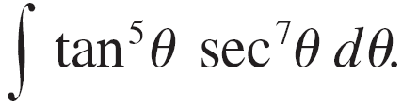

Example 6
Find
SOLUTION:
If we separate a sec²θ factor, as in the preceding example, we are left with a sec⁵θ factor, which isn’t easily converted to tangent.
However, if we separate a sec θ tan θ factor, we can convert the remaining power of tangent to an expression involving only secant using the identity

Slide 26
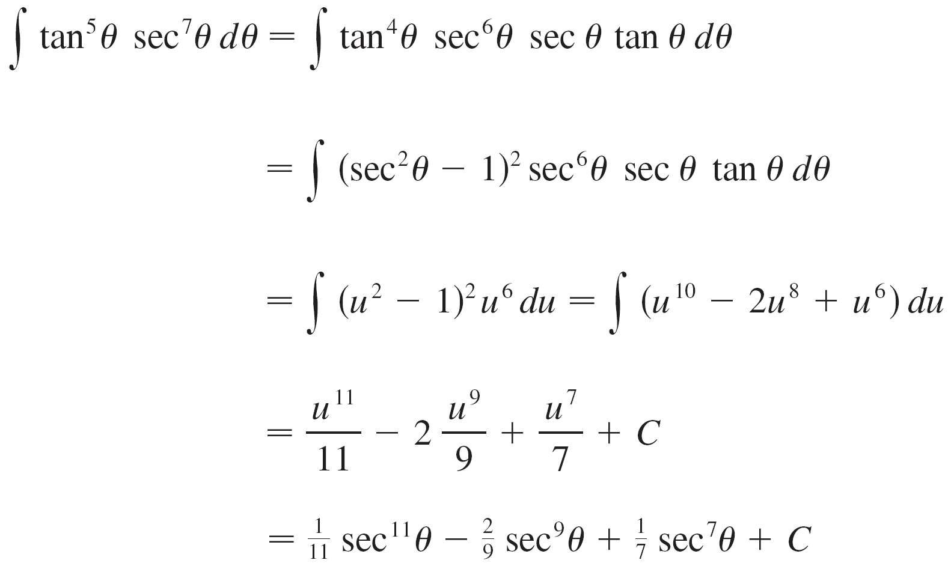
Example 6 – Solution
We can then evaluate the integral by substituting u = sec θ, so du = sec θ tan θ dθ :

Slide 27
Example 6 – Solution

Slide 28
TANGENT & SECANT INTEGRALS
The preceding examples demonstrate strategies for evaluating integrals in the form for two cases—which we summarize here.

Slide 29
How to Integrate Powers of tanx and secx STRATEGY (i)
If the power of secant is even (n = 2k, k ≥ 2) save sec²x.
Then, use tan²x = 1 + sec²x to express the remaining factors in terms of tan x:
Then, substitute u = tan x.

Slide 30
STRATEGY (ii)
If the power of tangent is odd (m = 2k + 1), save sec x tan x.
Then, use tan²x = sec²x – 1 to express the remaining factors in terms of sec x:
Then, substitute u = sec x.

Slide 31
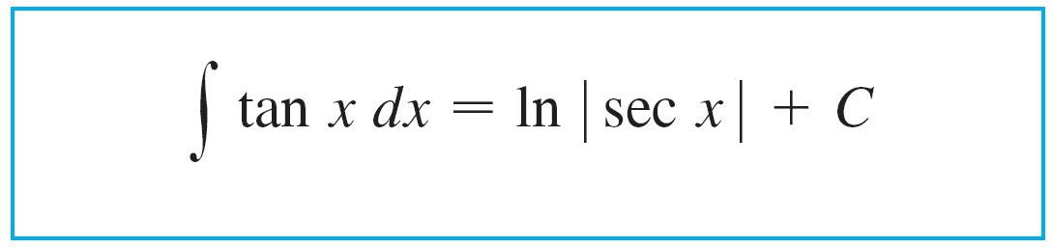
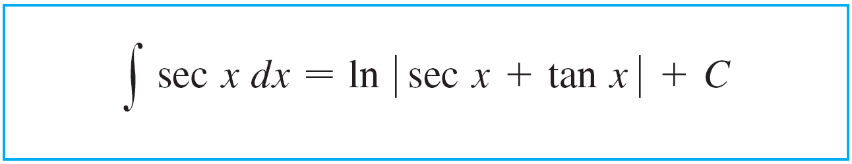

Trigonometric Integrals
For other cases, the guidelines are not as clear-cut. We may need to use identities, integration by parts, and occasionally a little ingenuity.
We will sometimes need to be able to integrate tan x:
We will also need the indefinite integral of secant:

Slide 32
TANGENT & SECANT INTEGRALS
We could verify Formula 1 by differentiating the right side, or as follows.
First, we multiply numerator and denominator by sec x + tan x:

Slide 33
TANGENT & SECANT INTEGRALS
If we substitute u = sec x + tan x, then du = (sec x tan x + sec²x).
The integral becomes:
Thus, we have:

Slide 34
Example 7
Find
SOLUTION
Here, only tan x occurs.
So, we rewrite a tan²x factor in terms of sec²x.

Slide 35
Example 7 – Solution
Hence, we use tan²x – sec²x = 1.
In the first integral, we mentally substituted u = tan x so that du = sec²x dx.

Slide 36
Trigonometric Integrals
If an even power of tangent appears with an odd power of secant, it is helpful to express the integrand completely in terms of sec x.
Powers of sec x may require integration by parts, as shown in the next example.

Slide 37
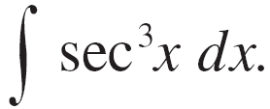
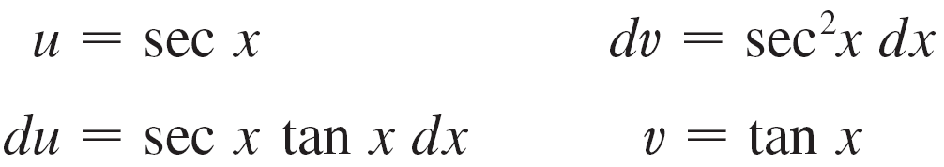
Example 8
Find
SOLUTION:
Here we integrate by parts with
Then

Slide 38
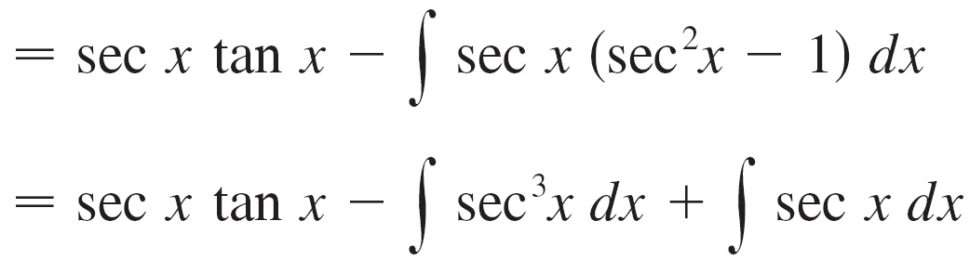
Example 8 – Solution
Using Formula 1 and solving for the required integral, we get

Slide 39
TANGENT & SECANT INTEGRALS
Integrals such as the one in the example may seem very special.
However, they occur frequently in applications of integration.
We will see this in Chapter 7.
Integrals of the form can be found by similar methods.
We have to make use of the identity 1 + cot²x = csc²x

Slide 40
Trigonometric Substitutions

Slide 41
TRIGONOMETRIC SUBSTITUTION
In finding the area of a circle or an ellipse, an integral of the form arises, where a > 0.
If it were , the substitution would be effective.
However, as it stands, is more difficult.

Slide 42
TRIGONOMETRIC SUBSTITUTION
If we change the variable from x to θ by the substitution x = a sinθ , the identity 1 – sin²θ = cos²θ lets us lose the root sign.
This is because

Slide 43
TRIGONOMETRIC SUBSTITUTION
Notice the difference between the substitution u = a² – x² and the substitution x = a sinθ.
In the first, the new variable is a function of the old one.
In the second, the old variable is a function of the new one.

Slide 44
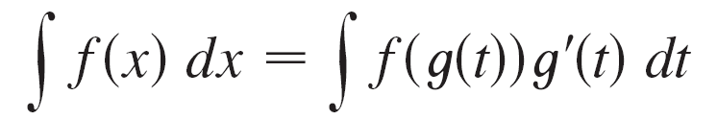
Trigonometric Substitutions
In general, we can make a substitution of the form x = g(t) by using the Substitution Rule in reverse.
To make our calculations simpler, we assume that g has an inverse function; that is, g is one-to-one.
Here, if we replace u by x and x by t in the Substitution Rule (Equation 4 in Section 4.5), we obtain:
This kind of substitution is called inverse substitution.

Slide 45
Trigonometric Substitutions
We can make the inverse substitution x = a sinθ, provided that it defines a one-to-one function.
This can be accomplished by restricting θ to lie in the interval [–p/2, p/2].
In the following table we list trigonometric substitutions that are effective for the given radical expressions because of the specified trigonometric identities.

Slide 46
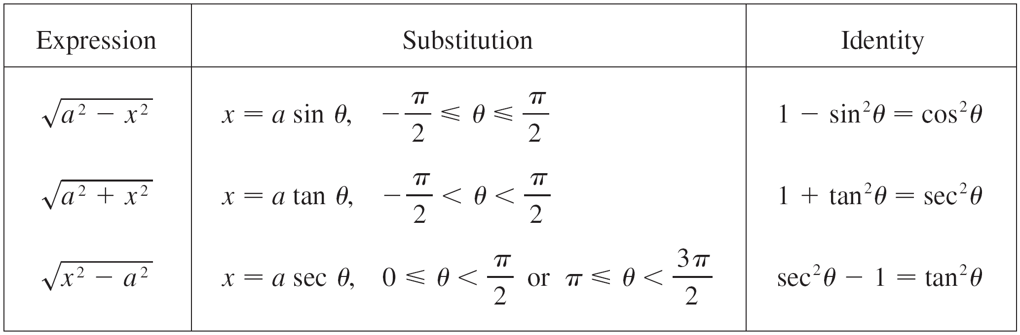
Trigonometric Substitutions
In each case, the restriction on θ is imposed to ensure that the function that defines the substitution is one-to-one.
These are the same intervals used in Section 5.6 in defining the inverse functions.
Table of Trigonometric Substitutions

Slide 47
Example 9
Evaluate
SOLUTION
Let x = 3 sinθ, where –π/2 ≤ θ ≤ π/2.
Then, dx = 3 cosθdθ and
Note that cosθ ≥ 0 because –π/2 ≤ θ ≤ π/2.

Slide 48
Example 9 – Solution
Thus, the Inverse Substitution Rule gives:

Slide 49
Example 9 – Solution
As this is an indefinite integral, we must return to the original variable x.
This can be done in either of two ways.
One, we can use trigonometric identities to express cotθ in terms of sinθ = x/3.

Slide 50
Example 9 – Solution
Two, we can draw a diagram, as in Figure 3, where θ is interpreted as an angle of a right triangle.
Since sinθ = x/3, we label the opposite side and the hypotenuse as having lengths x and 3.

Slide 51
Example 9 – Solution
Then, the Pythagorean Theorem gives the length of the adjacent side as
So, we can simply read the value of cotθ from the figure:
Although θ > 0 here, this expression for cotθ is valid even when θ < 0.

Slide 52
Example 9 – Solution
As sinθ = x/3, we have θ = sin^{–1}(x/3).
Hence,

Slide 53
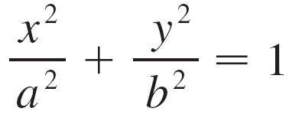
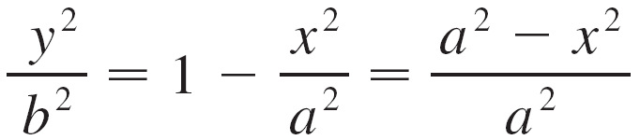
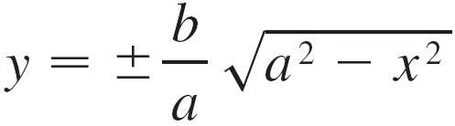
Example 10
Find the area enclosed by the ellipse
SOLUTION:
Solving the equation of the ellipse for y, we get
or

Slide 54
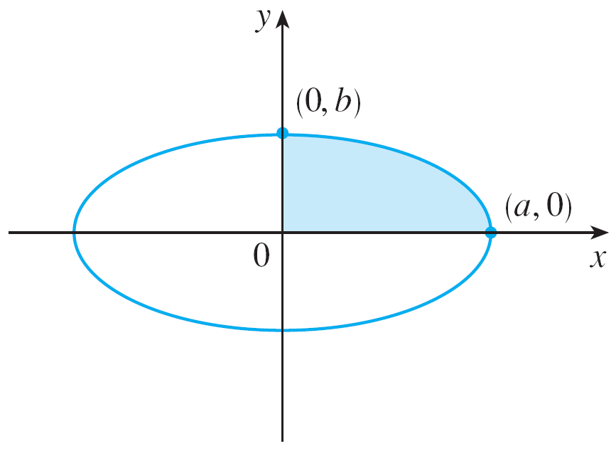
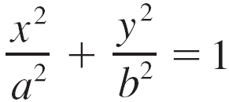
Example 10 – Solution
Because the ellipse is symmetric with respect to both axes, the total area A is four times the area in the first quadrant (see Figure 4).
Figure 4

Slide 55
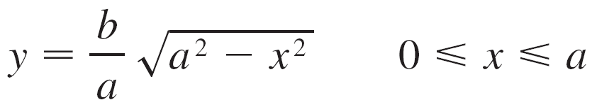
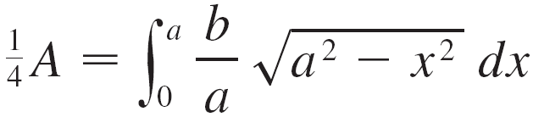
Example 10 – Solution
The part of the ellipse in the first quadrant is given by the function
and so
To evaluate this integral we substitute x = a sin θ. Then dx = a cos θ dθ.

Slide 56

Example 10 – Solution
To change the limits of integration we note that when x = 0, sin θ = 0, so θ = 0; when x = a, sin θ = 1, so θ =π /2.
Also
since

Slide 57
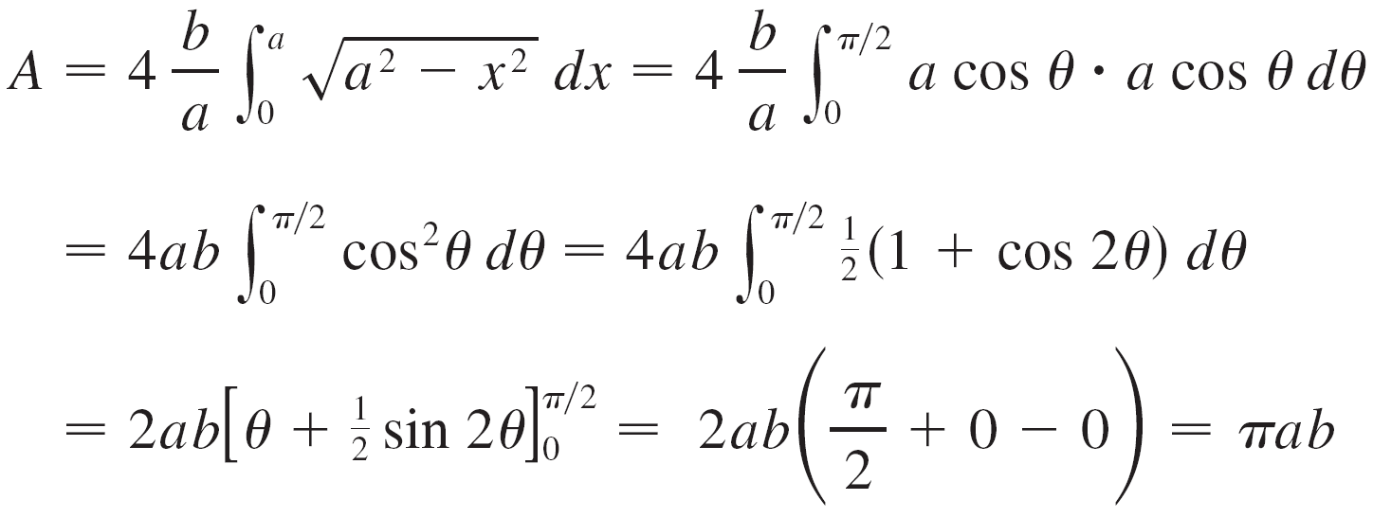
Example 10 – Solution
Therefore

Slide 58
Example 10 – Solution
We have shown that the area of an ellipse with semiaxes a and b is π ab.

Slide 59
Example 10 – Solution
In particular, taking a = b = r, we have proved the famous formula that the area of a circle with radius r is π r ².

Slide 60
Note
The integral in Example 10 was a definite integral.
So, we changed the limits of integration, and did not have to convert back to the original variable x.

Slide 61
Example 11
Find
SOLUTION:
Let x = 2 tanθ, –π/2 < θ < π /2.
Then, dx = 2 sec²θdθ and

Slide 62
Example 11 – Solution
Thus, we have:
To evaluate this trigonometric integral, we put everything in terms of sinθ and cosθ:

Slide 63
Example 11 – Solution
Therefore, making the substitution u = sinθ, we have:

Slide 64
Example 11 – Solution
We use Figure 5 to determine that:
Hence,

Slide 65
Example 12
Find
SOLUTION
It would be possible to use the trigonometric substitution x = 2 tanθ (as in Example 11).
However, the direct substitution u = x² + 4 is simpler.
This is because, then, du = 2x dx and

Slide 66
Note
Example 12 illustrates the fact that, even when trigonometric substitutions are possible, they may not give the easiest solution.
You should look for a simpler method first.

Slide 67
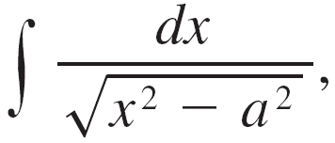
Example 13
Evaluate where a > 0.
SOLUTION:
We let x = a sec θ, where 0 < θ < π /2 or π <θ < 3π /2. Then dx = a sec θ tan θ dθ and

Slide 68
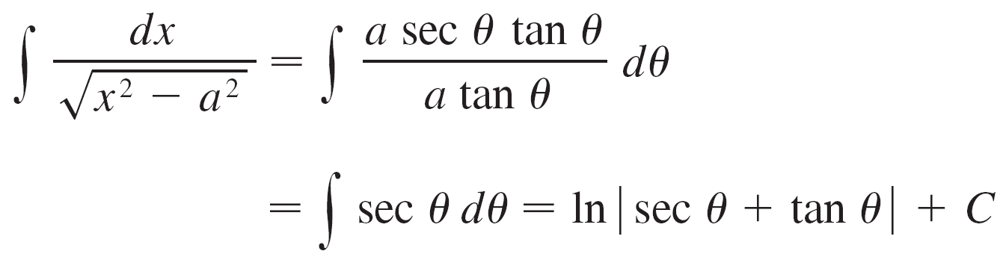
Example 13 – Solution
Therefore

Slide 69

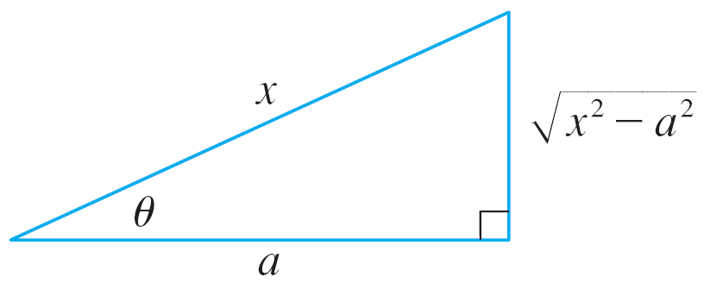
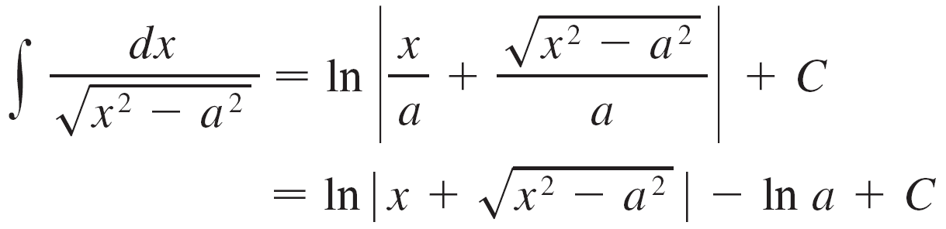
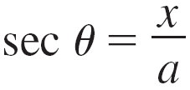
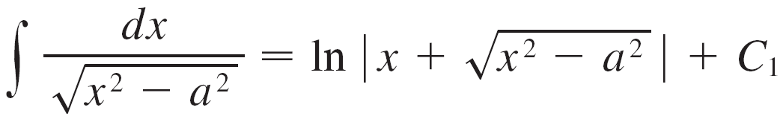
Example 13 – Solution
The triangle in Figure 6 gives so we have
Writing C₁ = C – ln a, we have
Figure 6

Slide 70
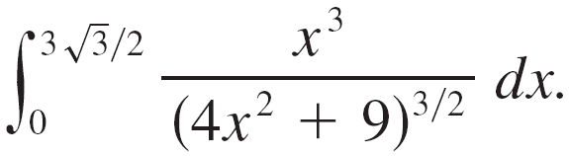


Example 14
Find
SOLUTION:
First we note that so trigonometric substitution is appropriate.
Although is not quite one of the expressions in the table of trigonometric substitutions, it becomes one of them if we make the preliminary substitution u = 2x.

Slide 71



Example 14 – Solution
When we combine this with the tangent substitution, we have which gives and
When x = 0, tan θ = 0, so θ = 0; when so θ = π /3.

Slide 72
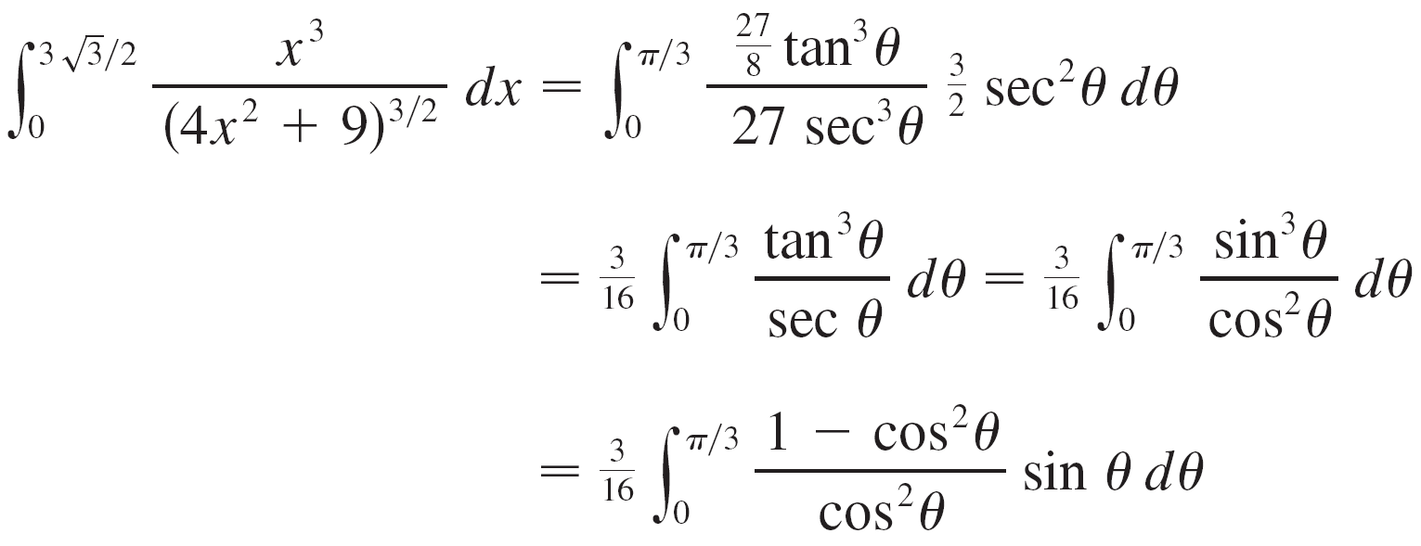
Example 14 – Solution

Slide 73

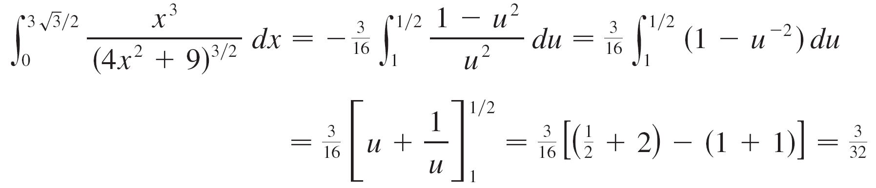
Example 14 – Solution
Now we substitute u = cos θ so that du = –sin θ dθ. When θ = 0, u = 1; when
Therefore

